Slide 1
Linear Algebra
Kuan Sao I
27th December 2019
Notes:
https://www.slideshare.net/ahra-cho/12-gramschmidt-orthogonalization
https://www.bilibili.com/video/av15971352?p=6
https://www.mathsisfun.com/algebra/vectors-cross-product.html

Slide 2
Content
Transformation
Basis transformation
Space transformation
Eigenvector Eigenvalue
Orthogonal matrix
SVD
LSA
Least-square
QR decomposition

Slide 3
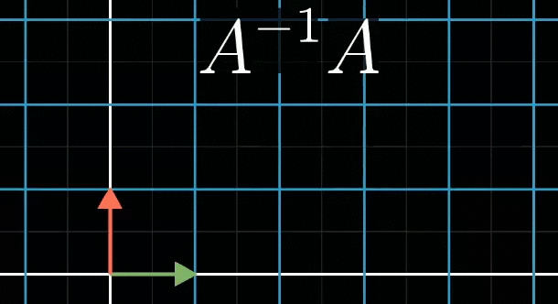
Transformation
Notes:
https://gfycat.com/discover/linear-algebra-gifs
https://gfycat.com/gifs/search/eigenvectors

Slide 4
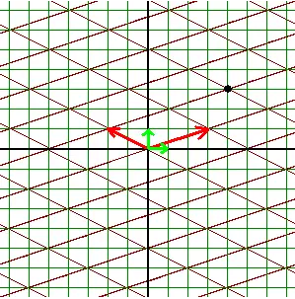
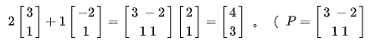
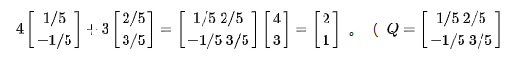
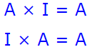
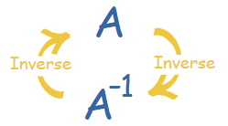
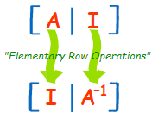
Basis transformation
Black dot:
Green basis(i,j) : (4,3)
Red basis(u,v): (2,1)
Assume i,j as basis, then u=(3,1), v=(-2,1)
Assume u,v as basis, then i=(1/5, -1/5), j=(2/5, 3/5)
A × A⁻¹ = I
Notes:
https://zhuanlan.zhihu.com/p/69069042

Slide 5
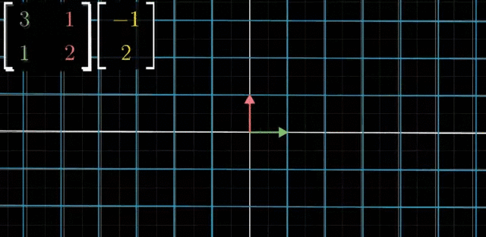
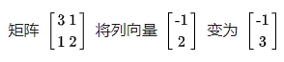
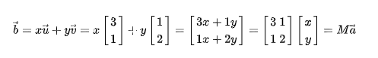
Space transformation
Ma=b
matrix
vector
to
Notes:
https://gfycat.com/discover/linear-algebra-gifs
https://gfycat.com/gifs/search/eigenvectors

Slide 6
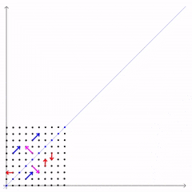
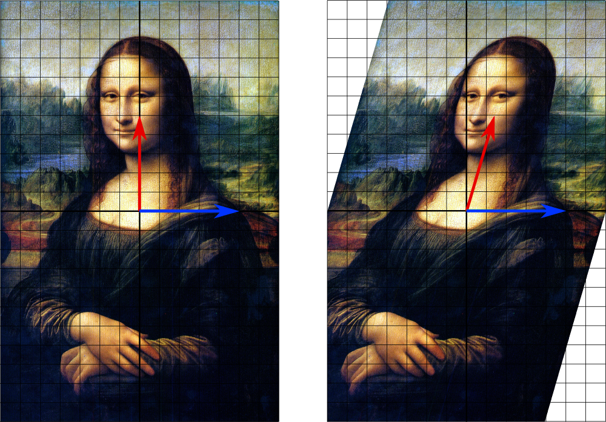
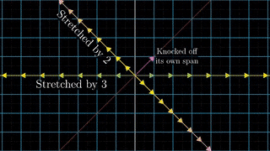
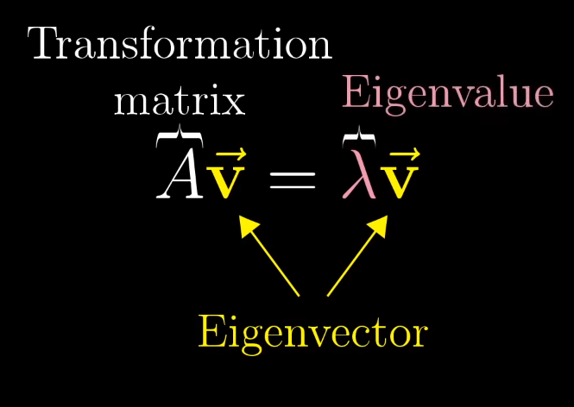
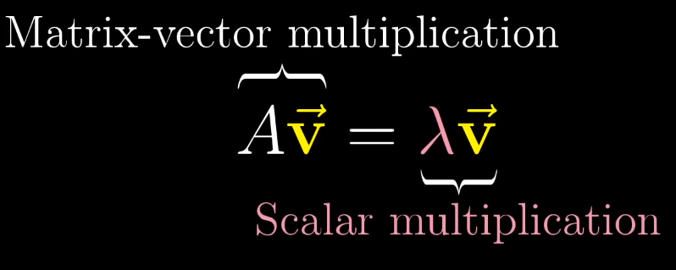
Eigenvector Eigenvalue
Notes:
https://www.youtube.com/watch?v=PFDu9oVAE-g
http://www.math.harvard.edu/archive/20_spring_05/handouts/ch05_notes.pdf

Slide 7
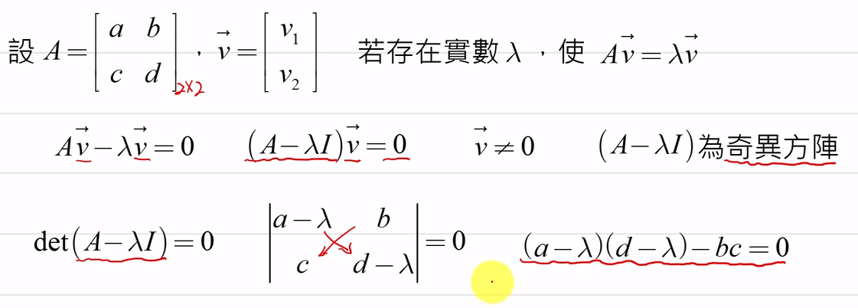
Eigenvector Eigenvalue
Assume
If λ is constant, let
<- singular matrix.
Notes:
https://www.youtube.com/watch?v=OGZX9CYYEic

Slide 8
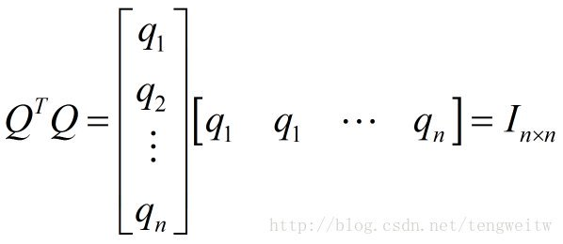
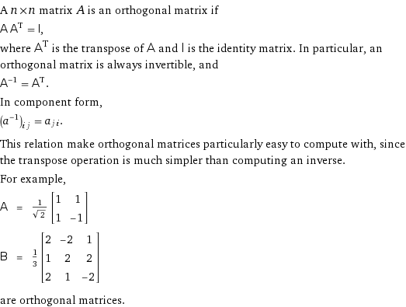
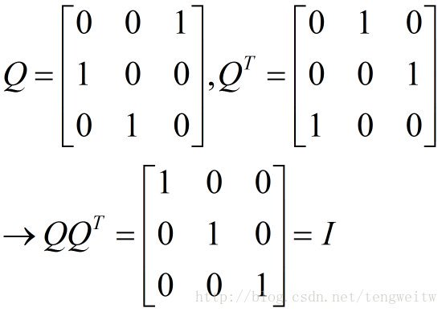
Orthogonal matrix
Notes:
http://mathworld.wolfram.com/OrthogonalMatrix.html

Slide 9
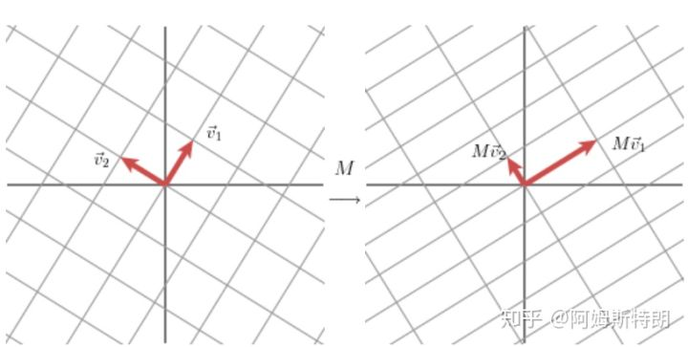
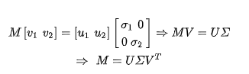
Singular Value Decomposition
Basis : u1, u2
Scalar: σ1,σ2
Orthogonal matrix: (v1, v2) -> V -> V^{T}
Notes:
https://zhuanlan.zhihu.com/p/69069183

Slide 10
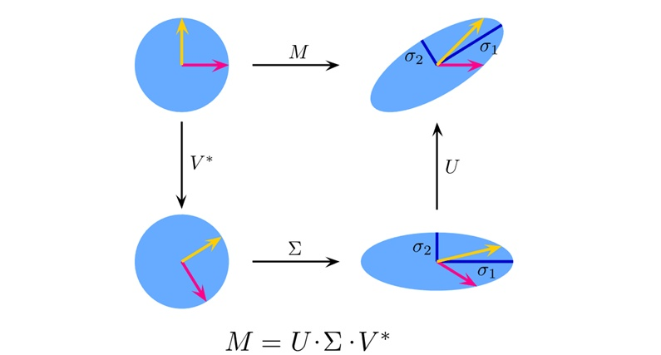

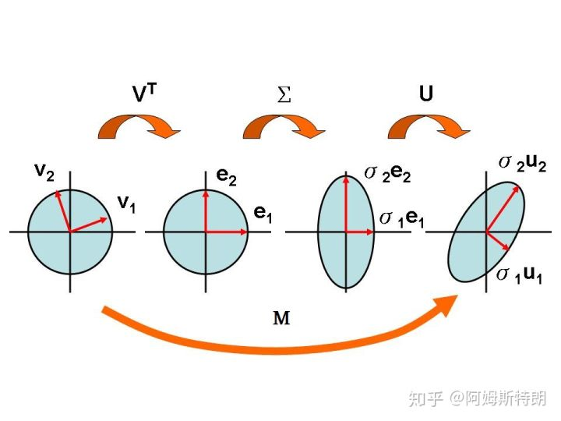
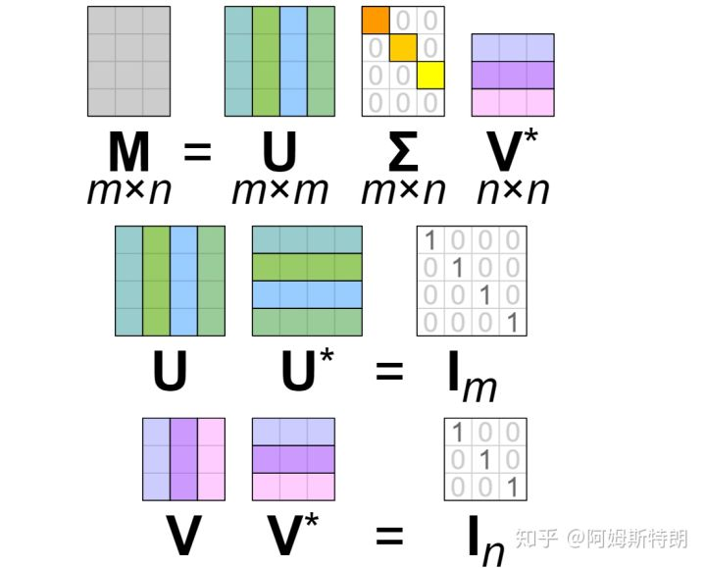
Singular Value Decomposition
Notes:
https://zhuanlan.zhihu.com/p/69069183

Slide 11
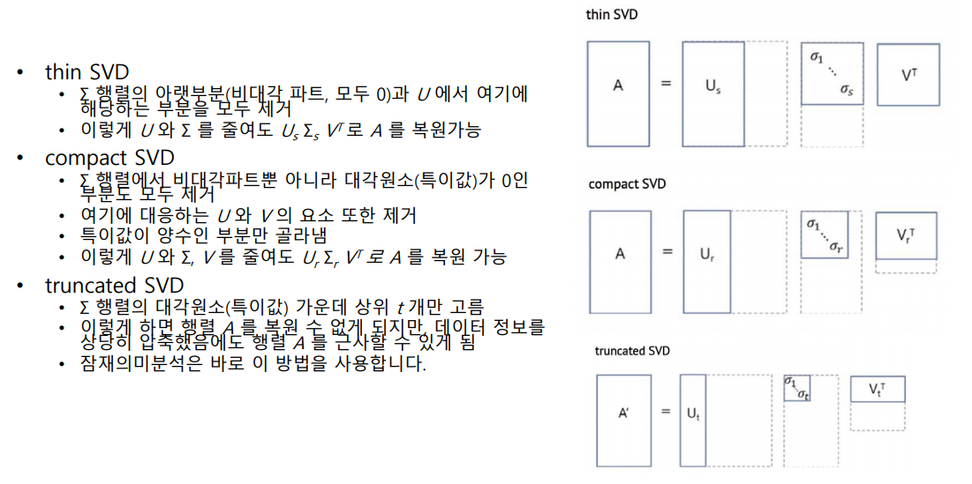
Singular Value Decomposition
Notes:
http://ling.snu.ac.kr/class/AI_Agent/lecture/07-2-0-SVDandLSA.pdf

Slide 12
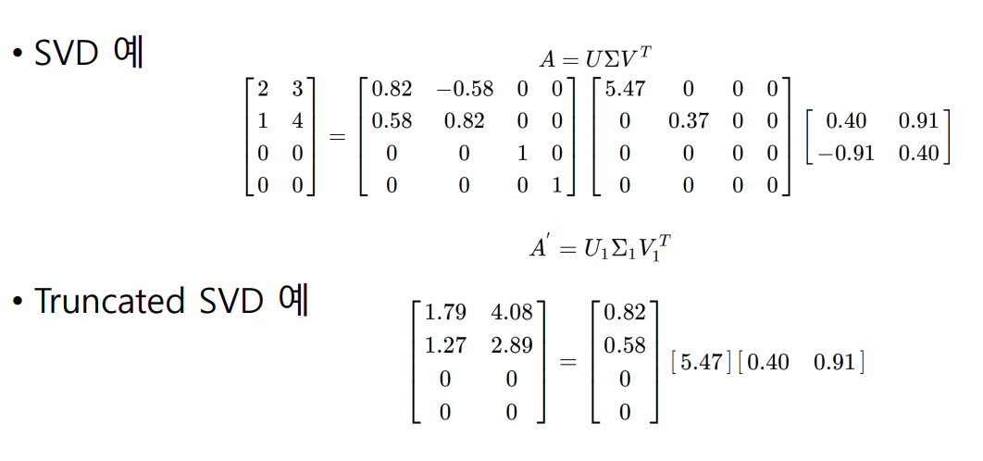
Singular Value Decomposition
Notes:
http://ling.snu.ac.kr/class/AI_Agent/lecture/07-2-0-SVDandLSA.pdf

Slide 13
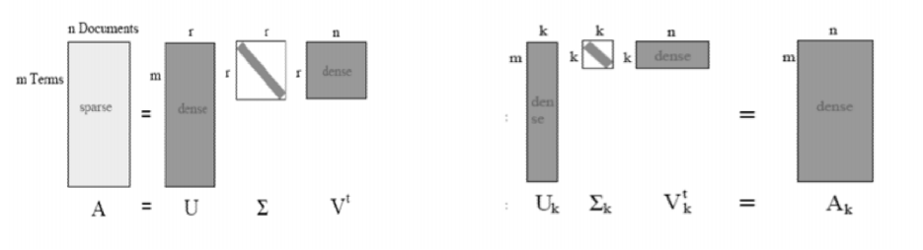
Singular Value Decomposition
Notes:
http://ling.snu.ac.kr/class/AI_Agent/lecture/07-2-0-SVDandLSA.pdf

Slide 14
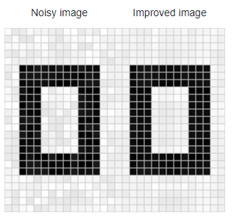

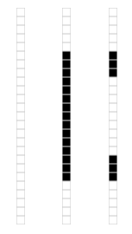
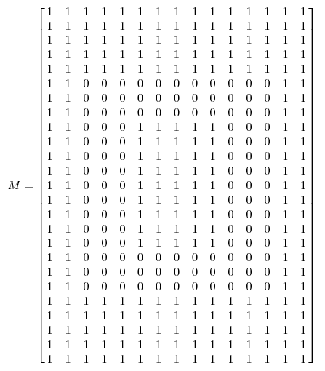
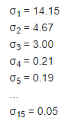
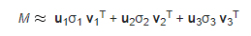
Singular Value Decomposition
Application:
Notes:
http://www.ams.org/publicoutreach/feature-column/fcarc-svd
https://www.bilibili.com/video/av15971352?p=2

Slide 15
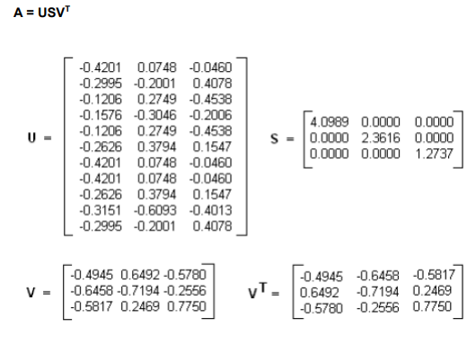
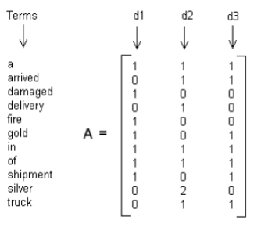
Latent Semantic Analysis
Application:
Notes:
http://www1.se.cuhk.edu.hk/~seem5680/lecture/LSI-Eg.pdf

Slide 16
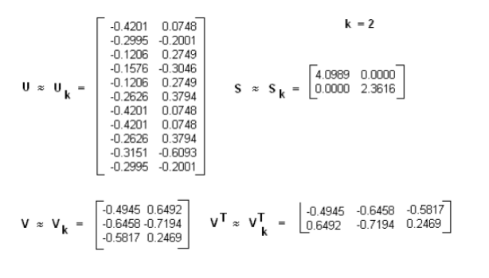
Latent Semantic Analysis
Application:
Notes:
http://www1.se.cuhk.edu.hk/~seem5680/lecture/LSI-Eg.pdf

Slide 17
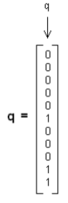
Latent Semantic Analysis
Application:
Notes:
http://www1.se.cuhk.edu.hk/~seem5680/lecture/LSI-Eg.pdf

Slide 18
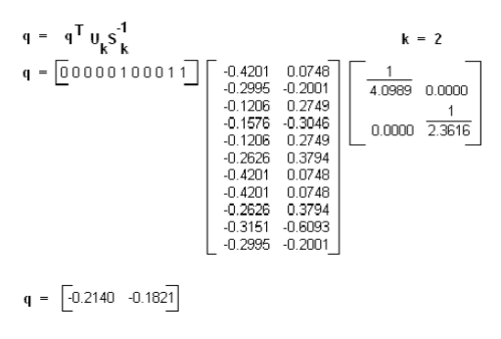
Latent Semantic Analysis
Application:
Notes:
http://www1.se.cuhk.edu.hk/~seem5680/lecture/LSI-Eg.pdf

Slide 19
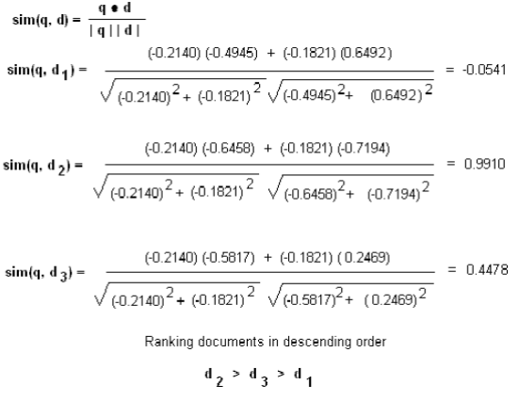
Latent Semantic Analysis
Application:
Notes:
http://www1.se.cuhk.edu.hk/~seem5680/lecture/LSI-Eg.pdf

Slide 20
The End
Kuan Sao I
27th December 2019

